Slide 1
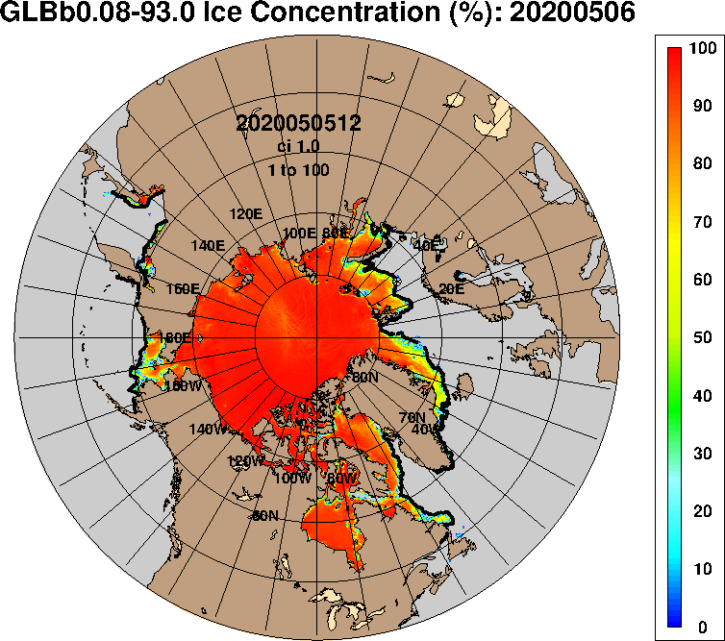

ADAC Year 8
ADAC Project Briefing
Oil Spill Modeling for Improved Response to Arctic Maritime Spills
Nancy E. Kinner and Tori Sweet
Coastal Response Research Center
Center for Spills and Environmental Hazards
University of New Hampshire
Image Source: https://www7320.nrlssc.navy.mil/GLBhycomcice1-12/arctic.html

Slide 2
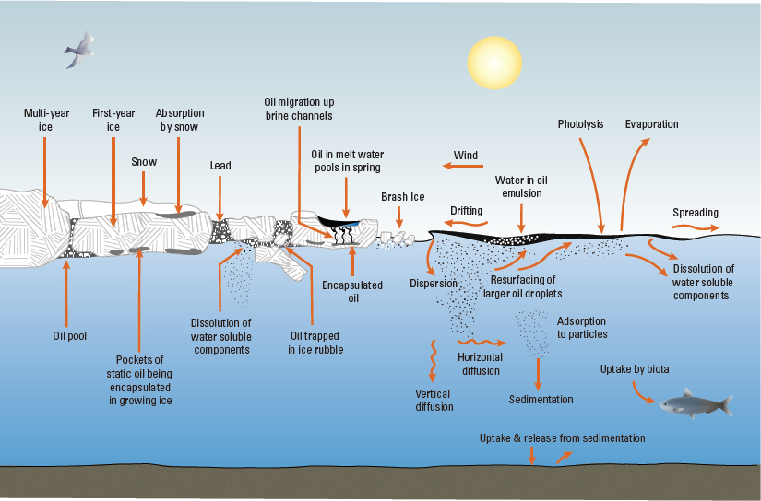
Oil Spill Modeling for Improved Response to Arctic Maritime Spills
Project Principal Investigators: Nancy E. Kinner
Lead Institution: University of New Hampshire Coastal Response Research Center (CRRC), Center for Spills and Environmental Hazards
Project Champion: Kristen Trego (HQ USCG 5RI)
Project Support:
  Sarah Allan (NOAA OR&R ARD)
  MST1 Gary Barnum (PacArea MST1)
  Catherine Berg (NOAA OR&R ERD SSC)
  Mike Donnellan (Alaska DEC)
  Mark Everett (USCG D17)
  Amy MacFadyen (NOAA OR&R ERD)
  Dr. Phillip McGillivary (USCG PacArea)
  LCDR Cliff Graham (HQ USCG MER)
Project Advocates: NOAA ORR and USCG PACAREA and D17
Oil and Ice Interactions
Source: Fisheries and Oceans Canada

Slide 3



Oil Spill Modeling for Improved Response to Arctic Maritime Spills
ADAC Fellows for AMSM Project
Megan Verfaillie’s Thesis Defense = May 18, 2021
Jessica Manning Senior Thesis = May 20, 2021
Tori Sweet = Senior graduating in May 22, 2022
Jessica Manning
Megan Verfaillie
Tori Sweet

Slide 4
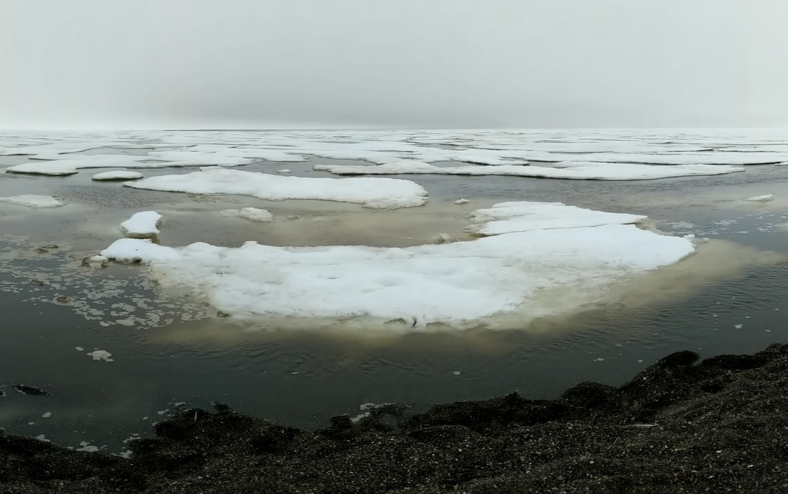
Oil Spill Modeling for Improved Response to Arctic Maritime Spills
Baseline: Arctic Environment
Arctic Specific Challenges:
  Limited response infrastructure / personnel
  Sparse observational data
  Extreme weather conditions
  Extended periods of darkness
  Long term impacts
  Lower temperatures impact oil behavior and weathering
  Ice is complex
  Oil may become frozen into ice

Slide 5
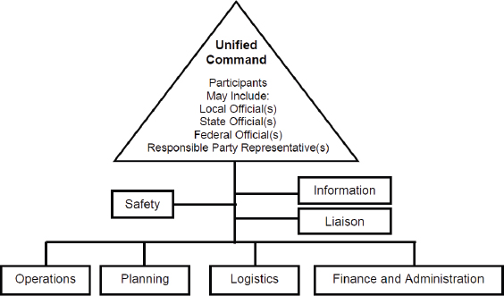
Oil Spill Modeling for Improved Response to Arctic Maritime Spills
Relevance: Emergency Response
Key Players:
  Incident Command System used by federal government for emergencies
  Unified Command:
    Develops objectives / strategies
    Improves information flow
    Optimizes combined efforts
  USCG responds to marine shipping accidents in U.S. waters
  NOAA ORR provides scientific support to USCG FOSC during oil spill response
Image Source: https://nrt.org/sites/2/files/UC%20TAD%201-26-07%20FINAL.pdf

Slide 6
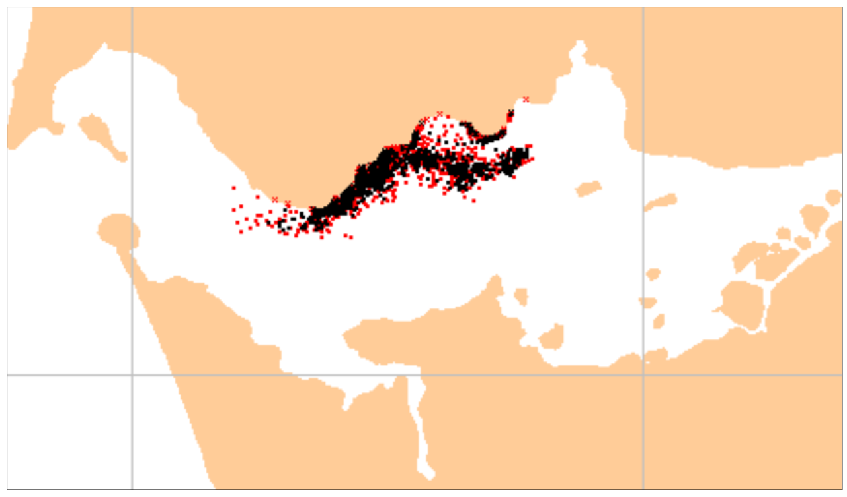
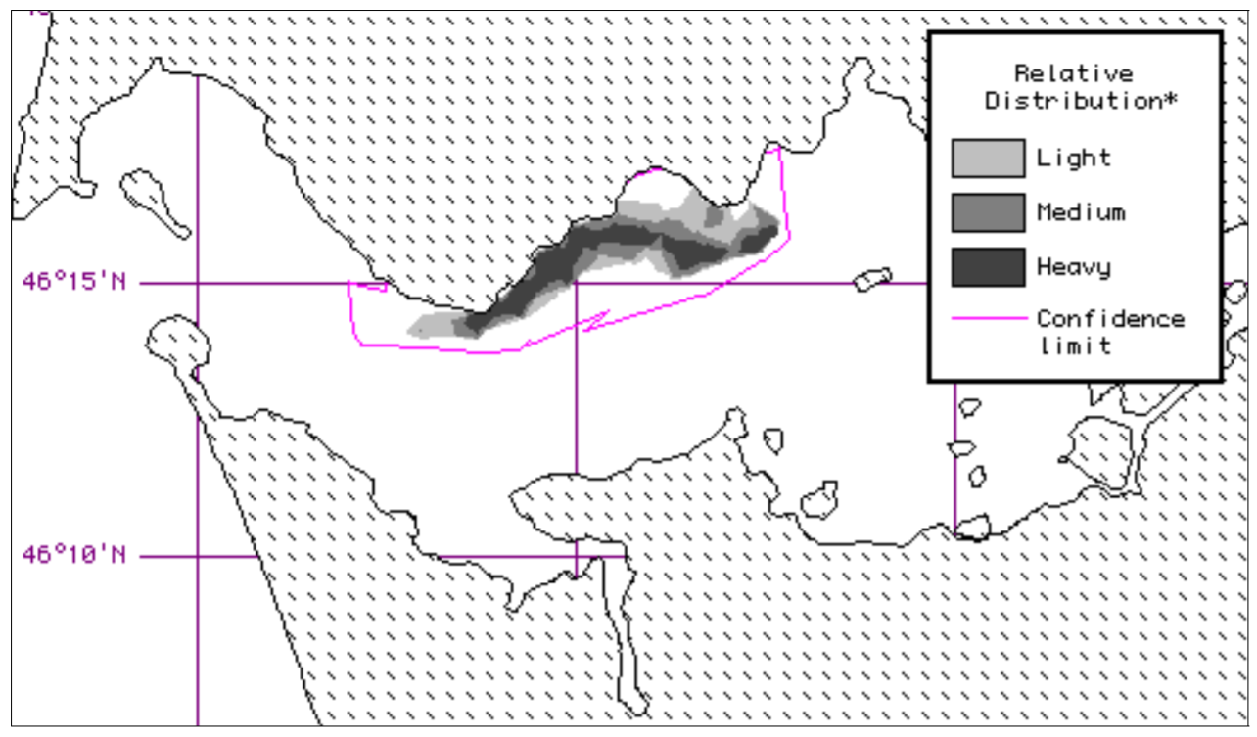
Oil Spill Modeling for Improved Response to Arctic Maritime Spills
Baseline : Oil Spill Models
Oil spill models:
  Predict the fate & transport of spilled oil
  Use a particle tracking (Lagrangian) based approach
  Are made in U.S. & internationally
  Public or private
Image Source: GNOME User Manual

Slide 7


Oil Spill Modeling for Improved Response to Arctic Maritime Spills
Baseline : Oil Spill Models
Response models must:
  Initialize quickly (provide answers within hours)
  Calibrate easily
  Model at a wide range of spatial / temporal scales
  Run with minimal data inputs
Primary U.S. Oil Spill Models
NOAA GNOME
RPS OILMAP & SIMAP

Slide 8

Transport
Fate (Weathering)
Oil Spill Models Predict:
Fate & Transport of Oil
Advection
Emulsification
Dispersion
Photo-Oxidation
Sedimentation
Dissolution
Biodegradation
Spreading
Evaporation

Slide 9
Oil Spill Models are Used for:
Directing Response Activities
Informing Stakeholders / Public
Analyzing Performance of
Cleanup Techniques
Identification of Habitats &
Species at Risk

Slide 10
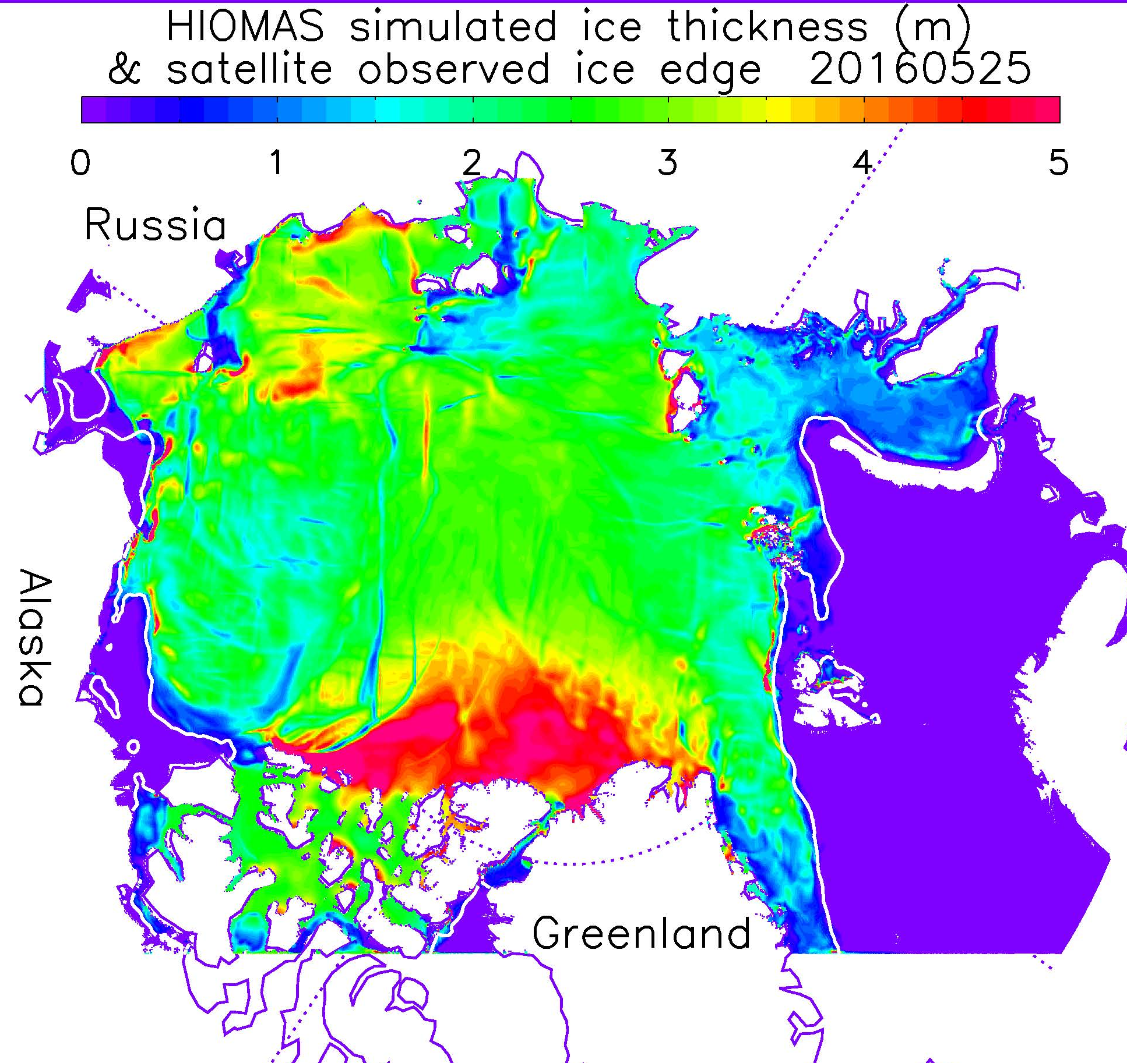
Oil Spill Modeling for Improved Response to Arctic Maritime Spills
Baseline: Ice Models
Simulate future data about ice conditions
Operate independent of oil spill models
  Essential for estimating spreading &
  transportation of oil in ice
  May be coupled with ocean, land, and/or atmosphere models
Provide long-term, seasonal, & short-term forecasts
Operate at global / climate (> 1 – 2 km) & “sub grid” scales (< 1 km)
Image Source: https://arcticdomainawarenesscenter.org/P08_HIOMAS

Slide 11
Oil Spill Modeling for Improved Response to Arctic Maritime Spills
Baseline : Ice Models
Ice Models Predict: Future Ice Conditions
Morphology
Physics
Thickness
Ice-Atmosphere
Ridges
Growth & Melt
Biogeochemistry
Floe Size
Ice-Ocean
Source: Adapted from Sea Ice Model Provenance Diagram by Andrew Roberts, Elizabeth Hunke, Bonnie Brown, and Nicole Jeffery

Slide 12
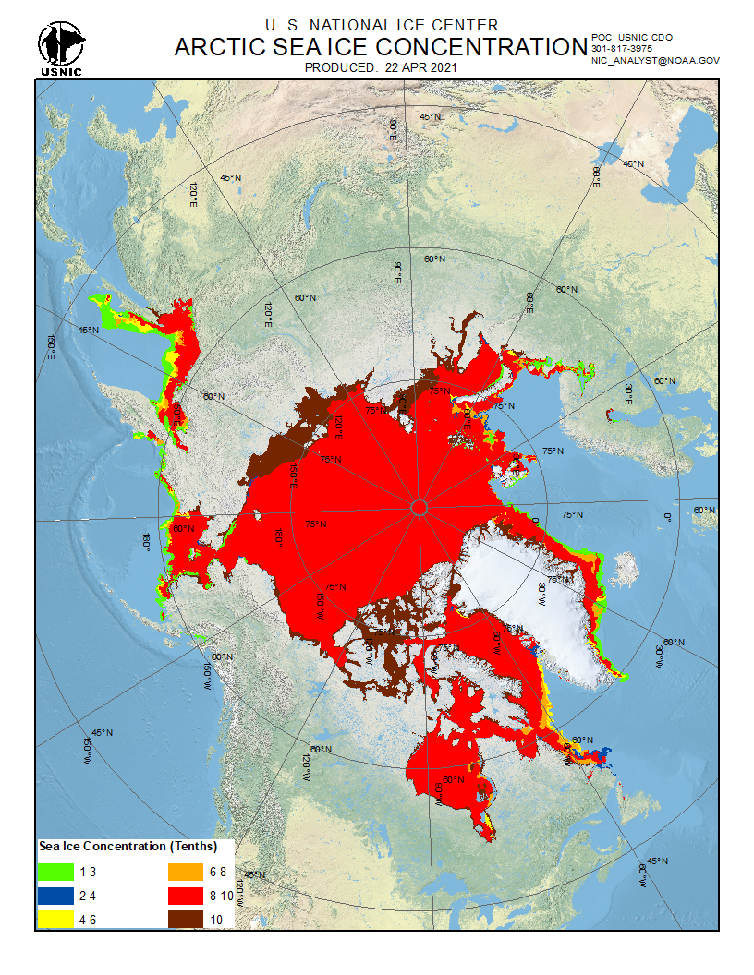
Oil Spill Modeling for Improved Response to Arctic Maritime Spills
Baseline : Ice Observing Systems
Use satellite resources to identify sea ice:
  Concentration
  Velocity
  Thickness
Information availability based on:
  Satellite orbits
  Radar calibration times
  Environmental conditions (e.g., clouds)
Can provide high resolution data (~10 m)
Use sea ice / hydrodynamic models to predict future conditions
U.S. National Ice Center & NWS AK Sea Ice Program

Slide 13
Description
Oil Spill Modeling for Improved Response to Arctic Maritime Spills Years 6-7
Project provides structured approach to gather expert advice to develop models that address USCG Federal On Scene Coordinator (FOSC) core needs during Arctic spill response.
Overall objective is to identify:
  Specific needs to be addressed to obtain models that will be functional and effective in response time scale to advance FOSC decision-making during an incident as well as improve experience gained from exercises and drills
  Current state-of-the-art Arctic maritime oil spill response models
  Potential integration of these models and components from recent research efforts (integration of ice models with oil spill models)
  Gaps in current models that need to be addressed by future research
Project outcome: Knowledge product/comprehensive report that delineates characteristics of Arctic oil spill response that make models appropriate required for daily response planning and decision-making

Slide 14
Oil Spill Modeling for Improved Response to Arctic Maritime Spills
Define Needs Addressed by Response Models
Project Core Team meeting held on May 2019
Produced Needs / Questions related to:
  Responder / FOSC Needs
  Overview & concerns for existing models
  Desired capabilities for new models
  Confidence level & communication
  Validation of models
  Suggestions for first workshop
Needs / Questions finalized by Core Team on July 31, 2019

Slide 15
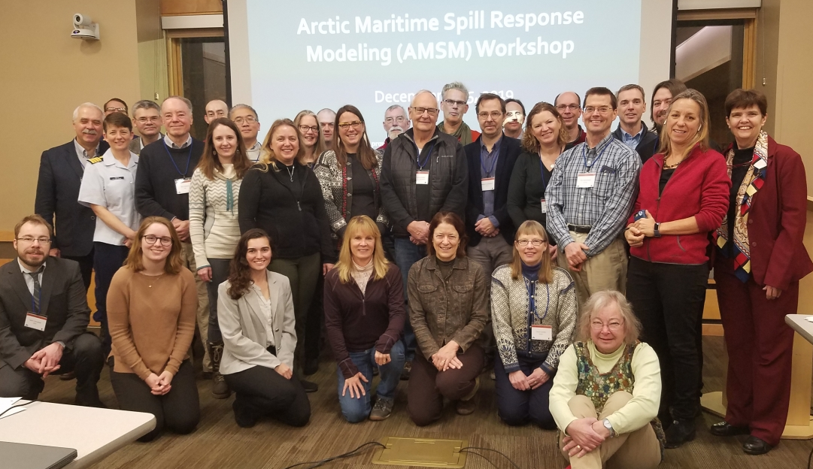
Oil Spill Modeling for Improved Response to Arctic Maritime Spills
Workshop 1 on AMSM Modeling
AMSM Workshop (December 3-5, 2019):
  49 participants from U.S. & International
  Presentations on oil spill & ice models available for Arctic
  Three different breakout group scenarios:
    Well blowout under ice
    Pipeline spill under landfast ice
    Large vessel spill of combinations of oil in the shoulder season (Fall)
  Workshop report completed January 2020

Slide 16
Oil Spill Modeling for Improved Response to Arctic Maritime Spills
Formation of Working Groups
Working Group Topics were determined at December 2019 workshop
Met March - November 2020
  Online every 3 weeks for 1 hour (~ 12 meetings
  per group)
  Each group has NOAA ORR modeling
  representative
Group Topics were determined at December 2019 workshop
Met March - November 2020
Working Group Topics
Oil & Ice Interactions at the Meter / “Sub Grid” Scale
Oil & Ice Interactions at the Kilometer + Scale
New and Existing Technologies for Observing Ice and Informing Models
Visualization & Uncertainty

Slide 17
Oil Spill Modeling for Improved Response to Arctic Maritime Spills
Virtual Workshop
Three parts:
  Workshop: November 16, 2020 (~ 75 participants)
  Stakeholder Working Session I: November 23, 2020
  Stakeholder Working Session II: November 30, 2020
Groups presented goals, research gaps, & findings
Stakeholder Working Sessions focused identifying research needs / scopes of work
9 workshop
Met March - November 2020

Slide 18
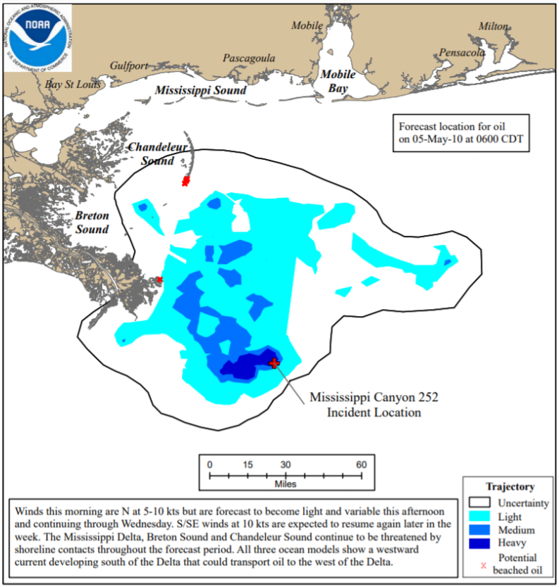
Oil Spill Modeling for Improved Response to Arctic Maritime Spills
Findings and Key Accomplishments
Communication of Uncertainty
FOSCs are concerned with:
  Most likely prediction
  Worst-case scenario
  Implications on response
Qualitative confidence level
(low, medium, high) sufficient
for decision-making
Spill modelers usually have idea
of qualitative uncertainty of outputs

Slide 19
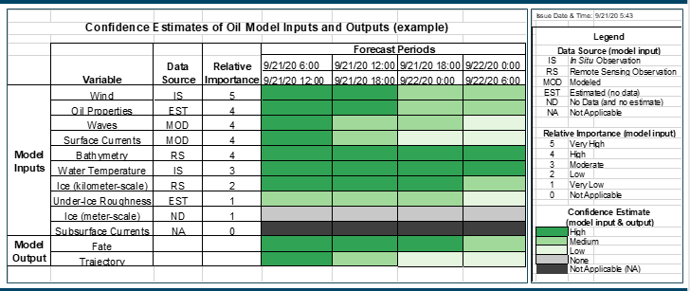
Oil Spill Modeling for Improved Response to Arctic Maritime Spills
Findings and Key Accomplishments
AMSM Confidence Estimates of Oil Model Inputs & Outputs (CEOMIO)
Identifies:
  Sources of uncertainty
  Qualitative confidence levels for
  inputs / outputs over spill duration
  Input data gaps & quality issues
Next step: sub-group of oil spill modelers and
SSCs using model output and data from
previous incidents to create draft tables
  Tables will be introduced to responders at a seminar and/or tabletop
  Also presented to other relevant groups (e.g., Alaska RRT)

Slide 20
Oil Spill Modeling for Improved Response to Arctic Maritime Spills
Findings and Key Accomplishments
AMSM Confidence Estimates of Oil Model Inputs & Outputs (CEOMIO)

Slide 21
Oil Spill Modeling for Improved Response to Arctic Maritime Spills
Findings and Key Accomplishments
Technology / Data Needs for Arctic Spill Response
Created spreadsheet describing:
  Contact / Manufacturer
  Overview
  Sensor Description
  Operating Conditions
  Spatial & Temporal Resolution
  Time Required for Measurements
  Availability / Time for Mobilization
  Permit Requirements
  Raw & Final Data Formats
  Validation Studies
Satellites
Airborne
On Ice Surface & Subsurface
Under Ice & Open Water Surface
Seafloor Mounted

Slide 22
Oil Spill Modeling for Improved Response to Arctic Maritime Spills
Findings and Key Accomplishments
Technology / Data Needs for Arctic Spill Response
Determined technology applicability and limitations for two spill scenarios:
Large Vessel Spill of Combinations of Oil in the Shoulder Season
Pipeline Spill Under Landfast Ice

Slide 23
Oil Spill Modeling for Improved Response to Arctic Maritime Spills
Findings and Key Accomplishments
State-of-the-Art Models
Completed a comprehensive review of state-of-the-art oil spill and ice models / forecast systems available
  Produced tables on state-of-the-art oil spill & ice models
    Spreadsheets include logistical information (e.g., scales, file formats), algorithms, necessary inputs, and outputs
  Oil spill modelers created lists of:
    Current limitations for oil in ice algorithms
    Outputs from sea ice models useful for improving Arctic oil spill modeling

Slide 24
Oil Spill Modeling for Improved Response to Arctic Maritime Spills
Findings and Key Accomplishments
Model Integration: Scale of Available Data
  Most ice models operate at the global / climate or sub grid scale
  Ice observing systems can produce needed resolution, but are limited by weather, satellite revisit periods & ingestion into models
Major obstacle for improving interoperability

Slide 25
Oil Spill Modeling for Improved Response to Arctic Maritime Spills
Findings and Key Accomplishments
Model Integration: Scale of Available Data
Oil spill modelers want data at 1 km spatial resolution & hourly temporal resolution
Challenging to produce at these scales
  1 km is intermediate scale between climate / global & sub grid scale
  Averaging of data across grid cells does not adequately represent regional scale processes in response timeframe
  Required computing power / data storage
  Technology limitations / data availability

Slide 26
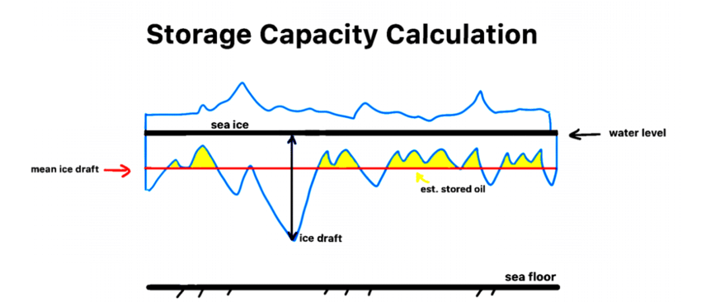
Oil Spill Modeling for Improved Response to Arctic Maritime Spills
Findings and Key Accomplishments
Many important small-scale oil-in-ice processes are not modeled
Most important is estimation of under ice storage capacity
  Based on roughness & stripping velocity
  Few data available for under ice conditions
  Relationship between under ice and surface conditions is not well understood
  “Rule of thumb” needed to estimate holding capacity of sea ice
CRRC is Currently Working on this Issue:
Jess Manning’s master's thesis research
Using CRRC flume
Advisory team includes researchers from AMSM working groups including Kelsey Frazier
Source: Kelsey Frazier, ADAC, December 2019 Workshop Presentation: “Oil and Ice”

Slide 27
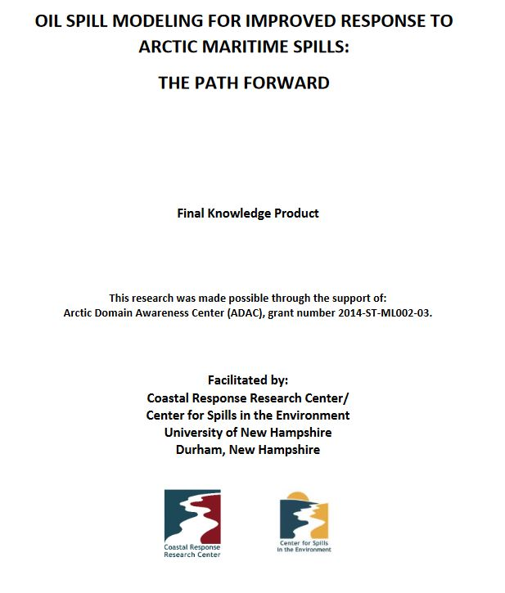
Oil Spill Modeling for Improved Response to Arctic Maritime Spills
Knowledge Product
Knowledge product/comprehensive report delineated characteristics of Arctic oil spill response that make models appropriate for daily response planning and decision-making
Key findings:
  Determine the exact sea ice model/observational data feeds that are needed by Arctic oil spill models
  Create, implement and test the code necessary to ensure that those data
can be ingested directly by oil models during spill in timely and accurate way
  Conduct test to validate sea ice inputs will lead to improved Arctic spill model trajectories
    Enhance FOSC decision-making
Source: Kelsey Frazier, ADAC, December 2019 Workshop Presentation: “Oil and Ice”

Slide 28
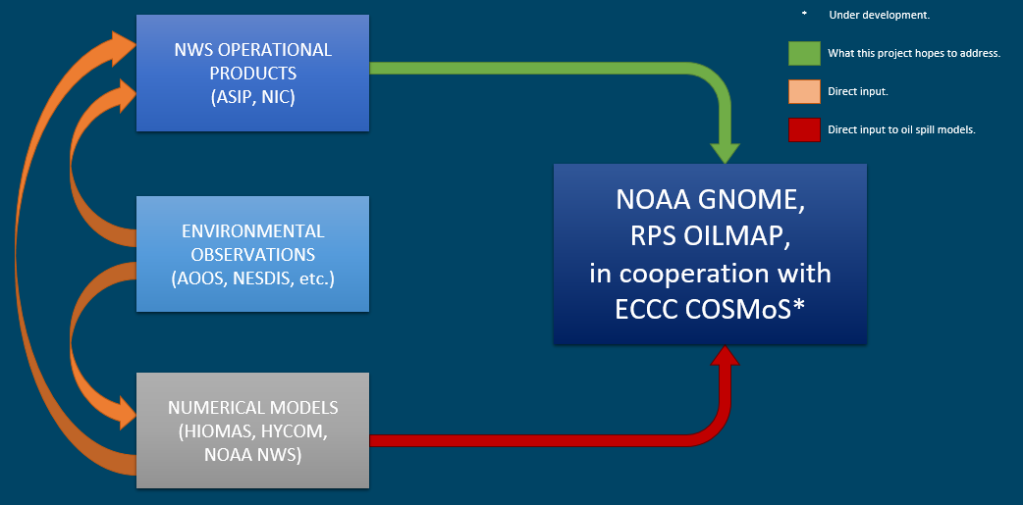
Oil Spill Modeling for Improved Response to Arctic Maritime Spills
Year 8: AMSM Path Forward
Year 8 determined necessary data feeds existing hydrodynamic and sea ice models to predict trajectory of oil in ice
  Coding to get data from
  ice models / services ready
  for ingestion into oil spill models
  Test linkage between ice and oil spill models

Slide 29
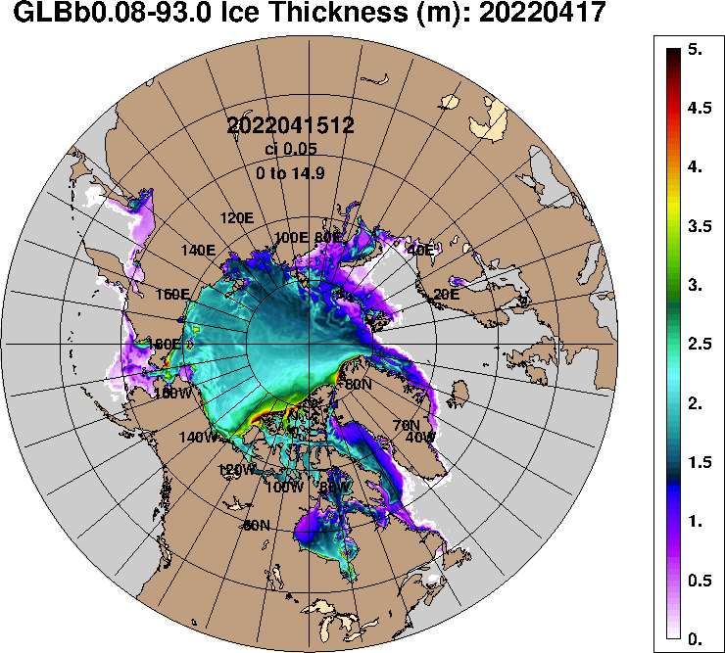
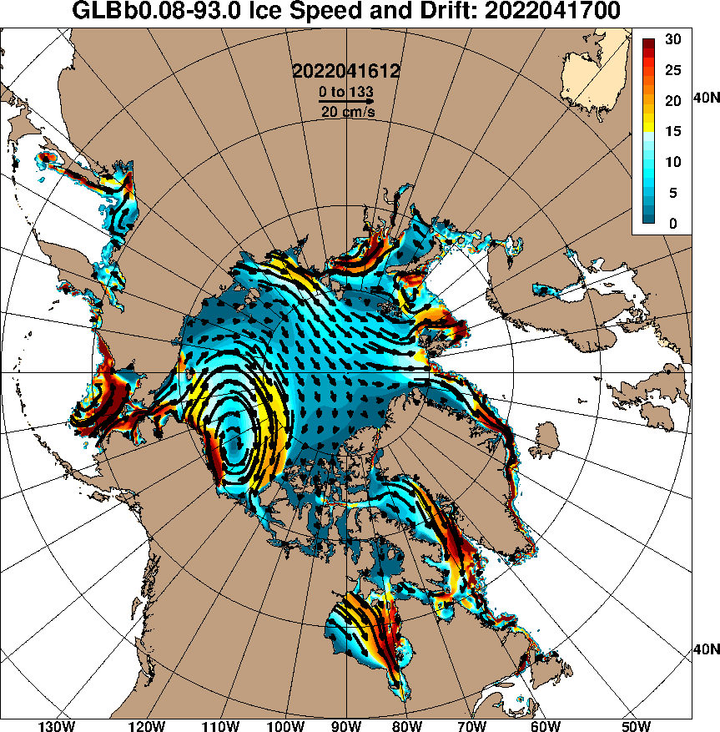
Oil Spill Modeling for Improved Response to Arctic Maritime Spills
Year 8: AMSM Path Forward
Parameters GNOME needs:
  Ice velocity, ice direction, % ice cover
  netCDF format
  Scale: 1 km
  Location: latitude and longitude
  Velocities: U and V (northing and easting)
  Winds: degrees from North and Velocity (knots)

Slide 30
Oil Spill Modeling for Improved Response to Arctic Maritime Spills
Year 8: AMSM Path Forward
Coordinating with NOAA ORR modelers on GNOME algorithms
  Coordination has occurred with:
    HIOMAS sea ice model already linked to GNOME
    Facilitated mtg with Zhang, Axiom Data Science and ORR
      Well coordinated already
      Too much computer power needed to 1 km resolution and 1 hour time interval with prediction up to 30 days
      If only up to 72 hr, less computer time required
      They can be flexible, if spill occurs

Slide 31
Oil Spill Modeling for Improved Response to Arctic Maritime Spills
Year 8: AMSM Path Forward
Coordinating with NOAA ORR modelers on GNOME algorithms
  Coordination has occurred with:
    AK Sea Ice Program
      Sea ice shapefiles
    NOAA National Environmental Satellite Data and Information Service (NESDIS)
      Satellite data can provide coverage of the Arctic, but there are gaps in data.
      Not at a 1 km scale, but a request could be made for this type of product to be produced in future and during spill

Slide 32
Oil Spill Modeling for Improved Response to Arctic Maritime Spills
Year 8: AMSM Path Forward
Coordinating with NOAA ORR modelers on GNOME algorithms
  Coordination with US National Ice Center (NIC)
      Uses GOFS (HYCOM + CICE) for data ingestion
      Can provide the data needs for GNOME (ice velocity, direction, and % ice cover)
      Not a 1 km scale, but potentially during an emergency/as needed basis
      Data originates in a netCDF format from GOFS
      Potential for GNOME to use data directly from GOFS and the NIC shapefiles/polygons for analysis

Slide 33
Oil Spill Modeling for Improved Response to Arctic Maritime Spills
Year 8: AMSM Path Forward
Coordinating with NOAA Sea Ice modelers on GNOME algorithms:
  Coordination has occurred with:
    CICE
      NOAA uses RTOFS (HYCOM + CICE) with slight difference from GOFS
      Can provide the data needs for GNOME (ice velocity, direction, and % ice cover).
      3 km scale for Arctic

Slide 34
Oil Spill Modeling for Improved Response to Arctic Maritime Spills
Year 8: AMSM Path Forward
Narrowed the search to two sea ice organizations:
  GNOME may eventually use
  both models to better determine
  uncertainty in trajectory prediction
Sea Ice Organization
NIC/US Navy
NOAA
GOFS: Ingests Data
(creates a physical field and replaces model’s data)
RTOFS: Assimilates Data (does not automatically replace the model’s data)

Slide 35
Oil Spill Modeling for Improved Response to Arctic Maritime Spills
Year 8: AMSM Path Forward
CRRC student computer programmer
  Currently working on coding sea ice data to input into GNOME
  Working with GOFS
  Once coding is completed, validation test will occur
  Scenario will be provided to modelers
    GOFS model will produce input for GNOME to ensure it can be ingested and GNOME will produce a plausible oil trajectory

Slide 36
Oil Spill Modeling for Improved Response to Arctic Maritime Spills
Year 8: AMSM Path Forward
Sea Ice Working Group
  Will be formed consisting of sea ice experts and oil spill modelers to ensure that sea ice data will be input into GNOME during Arctic spills in future
  Goals:
    Continued communication between sea ice and oil spill modelers
    Ensure that sea ice data continues to be compatible with GNOME coding
    Will be hosted semi-annually by CRRC
    Currently identifying sea ice experts for working group

Slide 37
Oil Spill Modeling for Improved Response to Arctic Maritime Spills
Year 8: AMSM Path Forward
Timetable:
  Begin coding immediately after coordination with sea ice modelers
  Test linkages in late Spring 2022
  June NOAA modelers and ice model/observation teams test system
  Finish Knowledge Product Addendum
Budget: No Issues

Slide 38
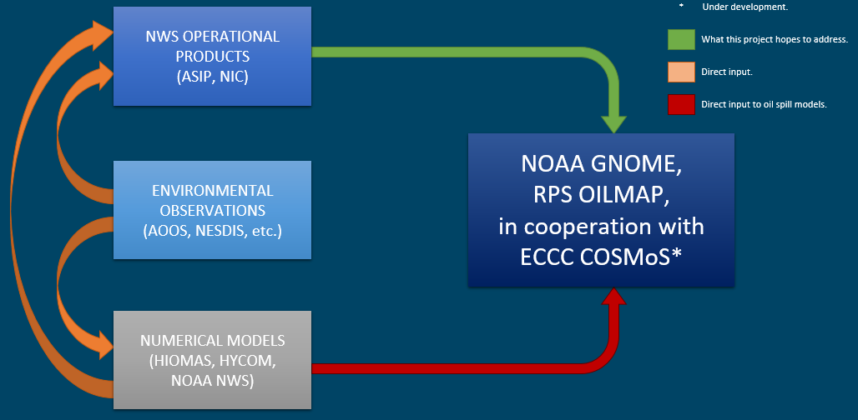
Questions?
Feedback…
What are we missing?
What can we improve?
Who should we connect with to improve odds of success?
Thank You Very Much for Listening
Notes:
Thank you for the gift of your time and attention.

